Slide 1


Slide 2
NINTENDO SWITCH Product & Strategy Analysis
Web Analytics
Ji Lyu Chang Liu
Tianyi Hu Ting Ding

Slide 3
Contents
01
ABSTRACT
02
DATA SET
03
ANALYSIS METHODOLOGY
04
RESULT
05
CONCLUSION

Slide 4
ABSTRACT
/01
Background
Business Goal

Slide 5
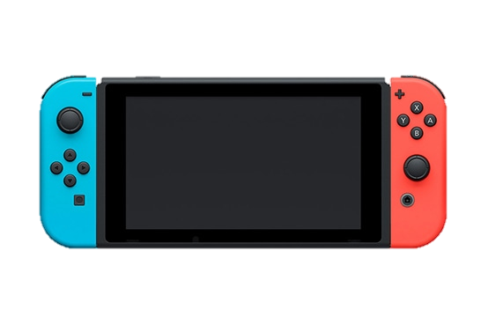
01. ABSTRACT
Background
Nintendo Switch was released in March 2017, almost 6 years after its last product Wii U.
Heat discussion before its release. Negative and Positive mixed together.
So delicious???
Business Goal
How do people like Nintendo Switch?
What’s the Strategy for next generation of Nintendo Switch?
How to carry on the Differentiation Strategy against PS & XBOX?

Slide 6
DATA SET
/02
Data Source
Data Description

Slide 7


02. DATA SET
Video: <First Look at Nintendo Switch> by Nintendo Official Channel
Tool: Youtube Data API, Googleapiclient
Crawling Content: Comments under the video
Volume: 73,679
Tweet: Based on keywords
Tool: Cursor
Crawling Content: Tweet, Location
Volume: 30,503

Slide 8
ANALYSIS METHODOLOGY
/03
NLTK | Word Frequency | Mapping | …

Slide 9
03. ANALYSIS METHODOLOGY
Sentiment Analysis
NLTK
Supervised
Regression
Word Frequency
Report
Unsupervised
Cluster
Competitor Comparison
Comparison Table
Location Filter
Map Figure

Slide 10
RESULT
/04
Sentiment Analysis | Data Mining | Comparison | Location

Slide 11
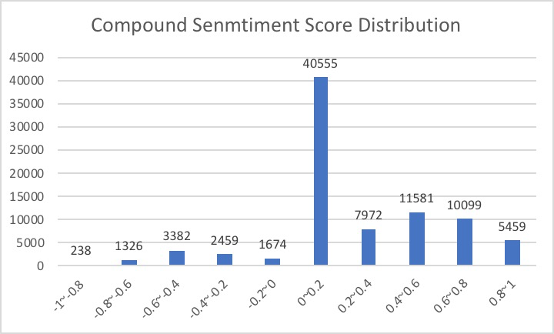
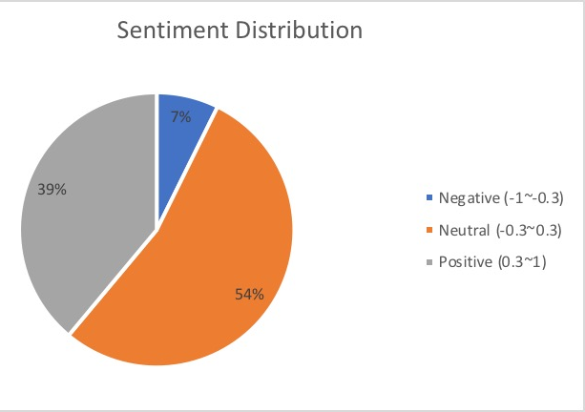
04. RESULT – SENTIMENT ANALYSIS
Statistic Analysis about Compound Sentiment Scores
Average | Mode | Median | Standard Deviation
0.19570891 | 0 | 0 | 0.36775081

Slide 12
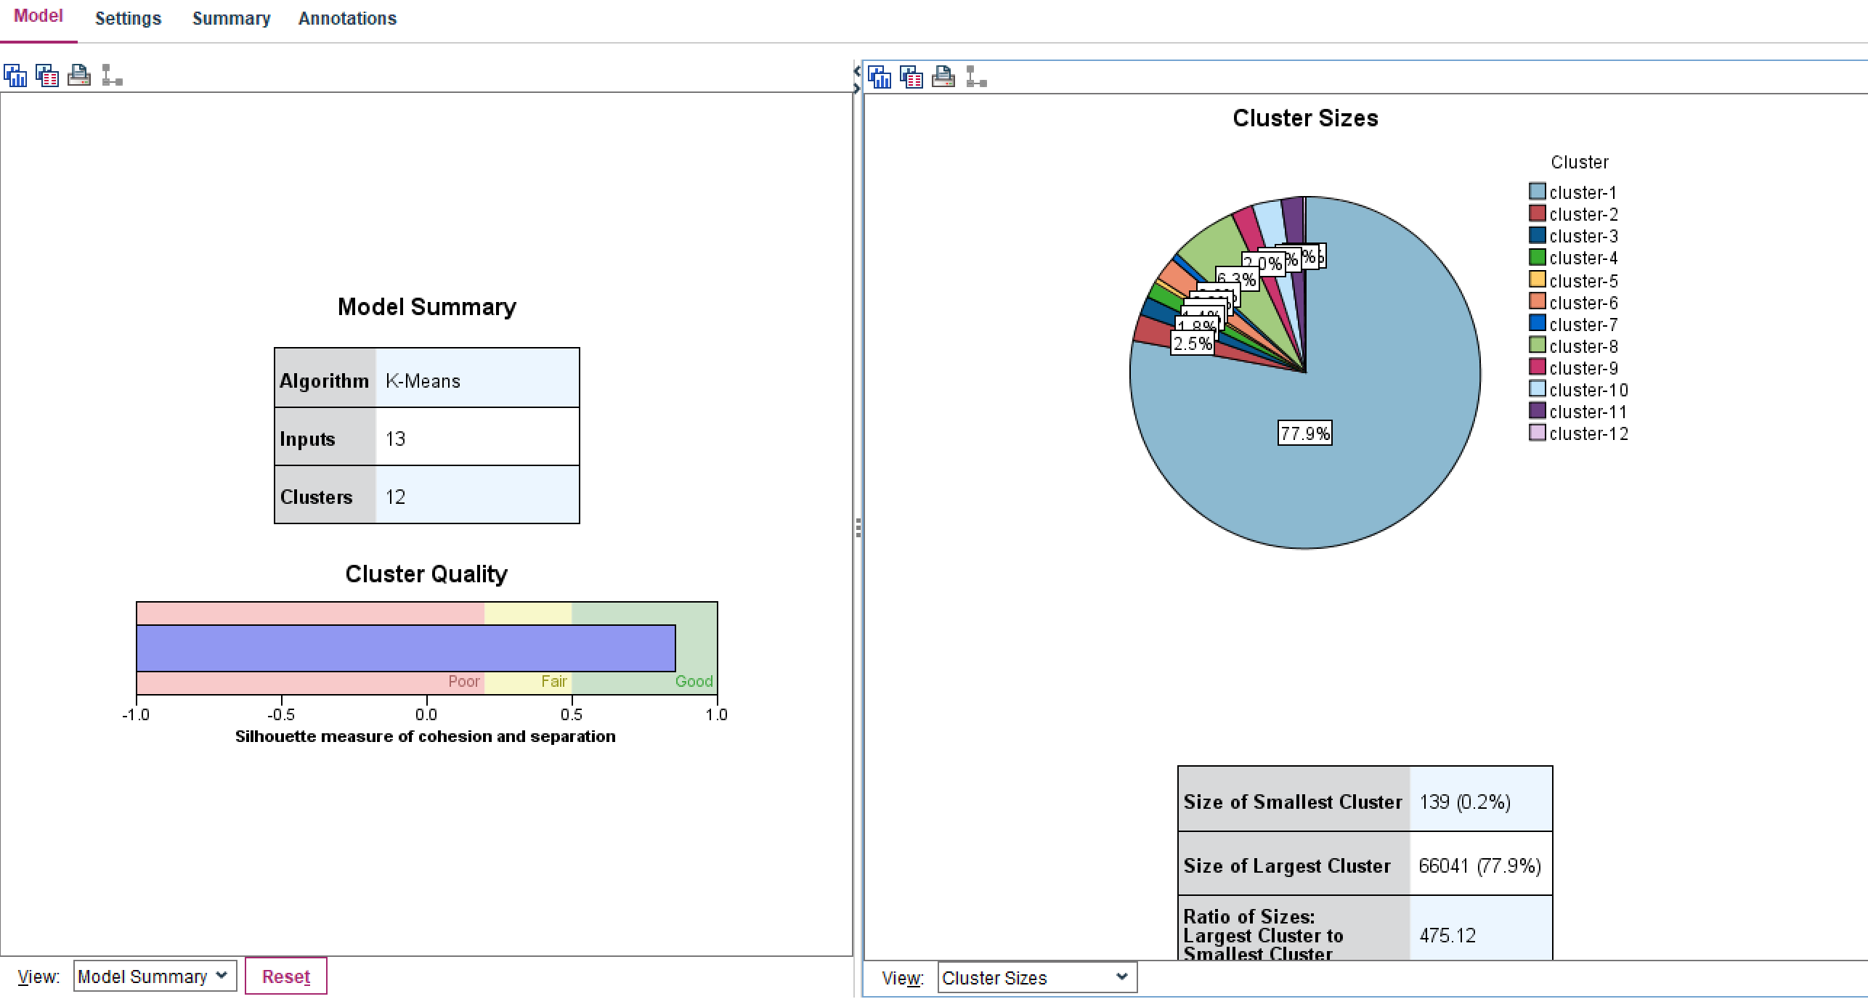
04. Unsupervised & Supervised Data Mining Models
We choose frequencies of 13 adjectives and verbs to create a dataset for unsupervised data mining.
cool | better | awesome | amaze | new | like | want | buy | wait | need | love | omg | best
K-means
Cluster
Model

Slide 13
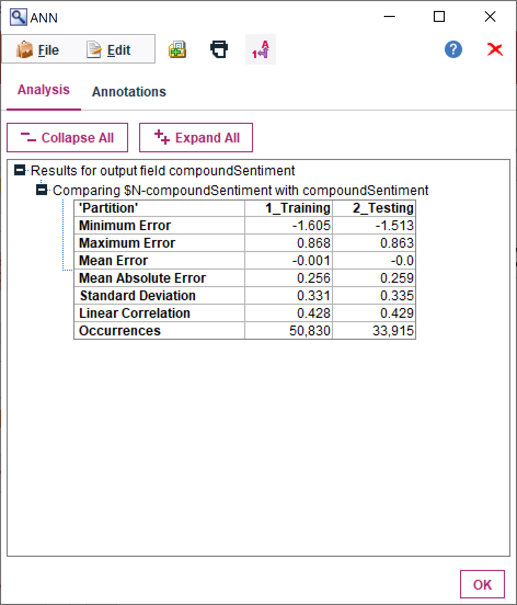
04. Unsupervised & Supervised Data Mining Models
We also insert compound sentiment scores into this dataset for supervised data mining.
cool | better | awesome | amaze | new | like | want | buy | wait | need | love | omg | best | scores
ANN
Regression
Model
Analysis

Slide 14
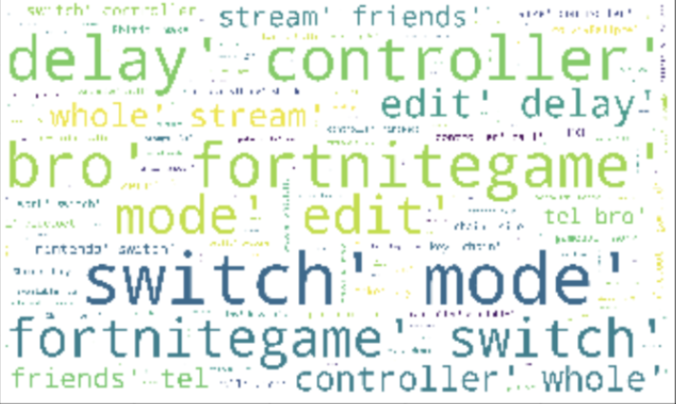
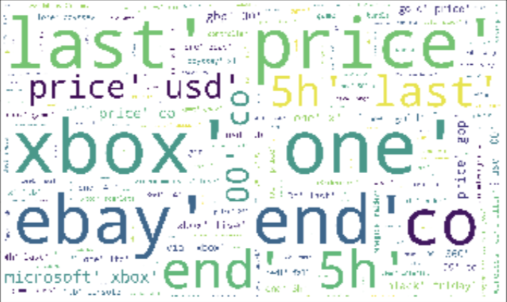
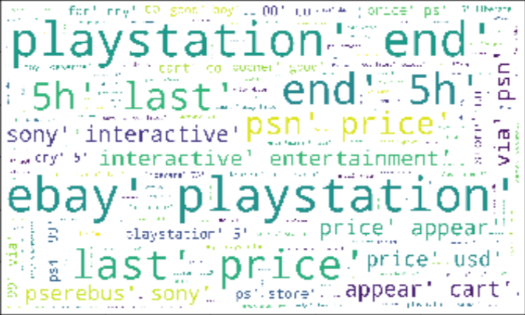
04. Word Clouds of Three Products

Slide 15
04. RESULT – NS vs PS vs XBOX
 | Nintendo Switch | Word Frequency | PlayStation | Word Frequency | Xbox | Word Frequency
Controller | delay-592 -46.83% 8bitdo-182-14.40% small-38-3.00% | 1264 | light-35 -1.71% botton-19 -0.93% keypad-14-0.68% | 2044 | handheld-287- 7.56% wireless-204-5.37% adaptive-59 -1.55% | 3798
Games | YouTube-200-4.97% smash-180 -4.47% community-155-3.85% | 4024 | year-144 -6.38% official-99-4.38% bundle-36-1.59% | 2258 | free-34-2.32% membership-34-2.32% | 1464
Price | lite-452-11.79% holiday-358-9.33% mobile-209-5.45% | 3834 | ebay-892-16.48% used-321 -5.93% holiday-212-3.92% season-209-3.86% | 5413 | ebay-428-15.83% used-139-5.14% bundle-86-3.18% | 2704
Graphics | brilliant-18-9,57% good-9-4.79% cutting-edge-8-4.26% | 188 | reality-22 -7.56% worst-22-7.56% self-esteem-22-7.56% self-confident-22-7.56% | 291 | original-193.66% battery-173.28% amaze-13-2.50% | 519

Slide 16
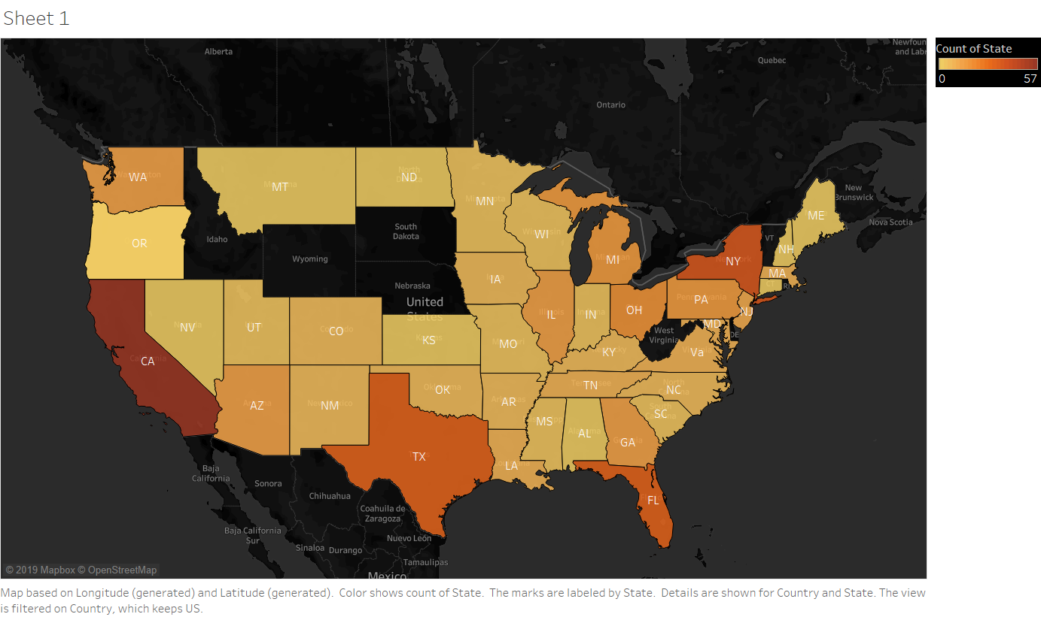
04. Twitter Location Heat Map in US
Rankings
CA
NY
TX, FL

Slide 17
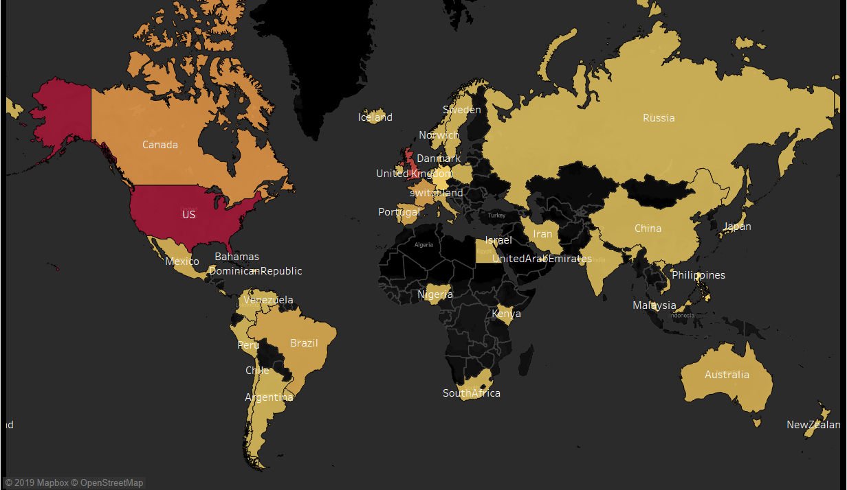
04. Twitter Location Heat Map Worldwide
Rankings
US
UK
Canada
China?

Slide 18
CONCLUSION
/05
Technical Conclusion
Managerial Suggestion

Slide 19
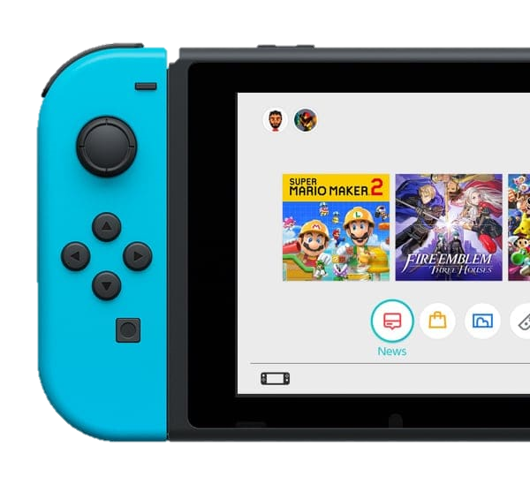
05. CONCLUSION
Conclusion
How do people like Nintendo Switch?
Most neutral, Generally Positive, Few Negative
What’s the Strategy for next generation of Nintendo Switch?
Marketing in target place, Improve controller
How to carry on the Differentiation Strategy against PS & XBOX?
Game streamer, Release amazing games, Proper iteration

Slide 20
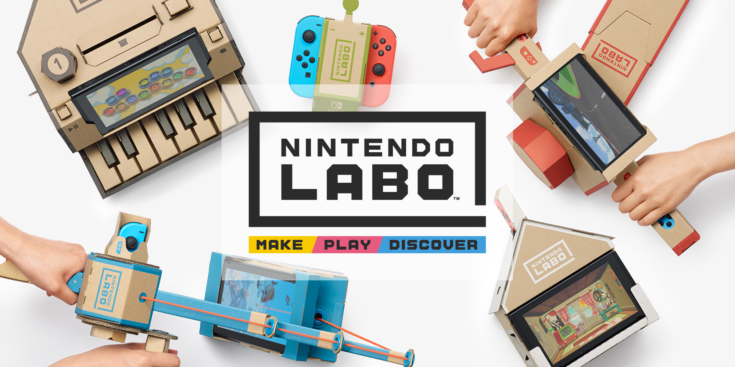
Thank You

